Slide 1
What are they Jobs like?
Reading: Jobs Profile
By Carlos Alberto Gonçalves
4th Semester

Slide 2
Placement of adjectives
Be + adjectives
Adjective + a noun
A doctor’s job is stresssful.
A teacher’s job is interesting.
- A doctor has a stressful job.
- A teacher has an interesting job.

Slide 3
What’s your job like?
Be + adjective
Adjective + noun
A doctor’s job is difficult.
A professor’s job is stressful.
A police officer’s job is dangerous.
A dancer’s job is exciting.
A doctor has a difficult job.
A professor has a stressful job.
A police officer’s job is dangerous.
A dancer has an exciting job.

Slide 4
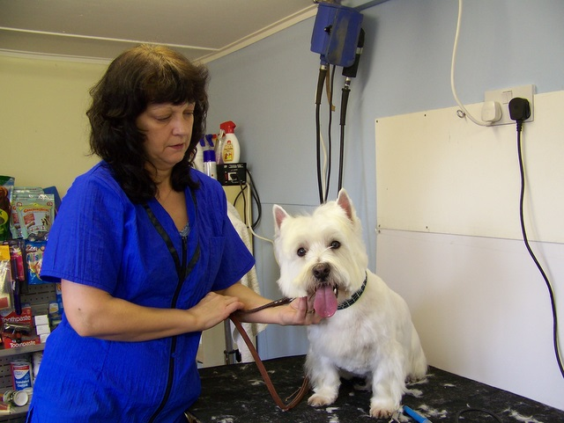
Job Profiles
Dog Groommer
Marco Mendez
Lot’s of Marco Mendez’s friends walk on four legs. He makes these furry friends beautiful. Marco is a professional dog groomer. He likes his job a lot because it’s never boring. Each dog has a different personality. What’s his favorite kind of dog? He’s not telling!

Slide 5
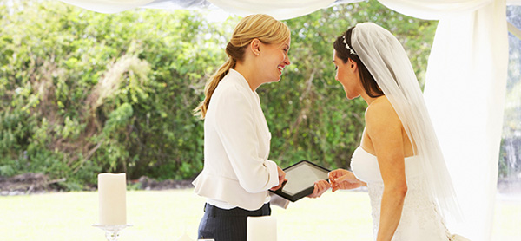
Job Profiles
Wedding planner
Lila Martin
Lila Martin goes to nice restaurants, eats cake, listens to bands – and gets paid for it! Lila is a wedding planner. She chooses the place, the food, and the music for people’s weddings! It’s stressful because everything needs to be perfect!

Slide 6
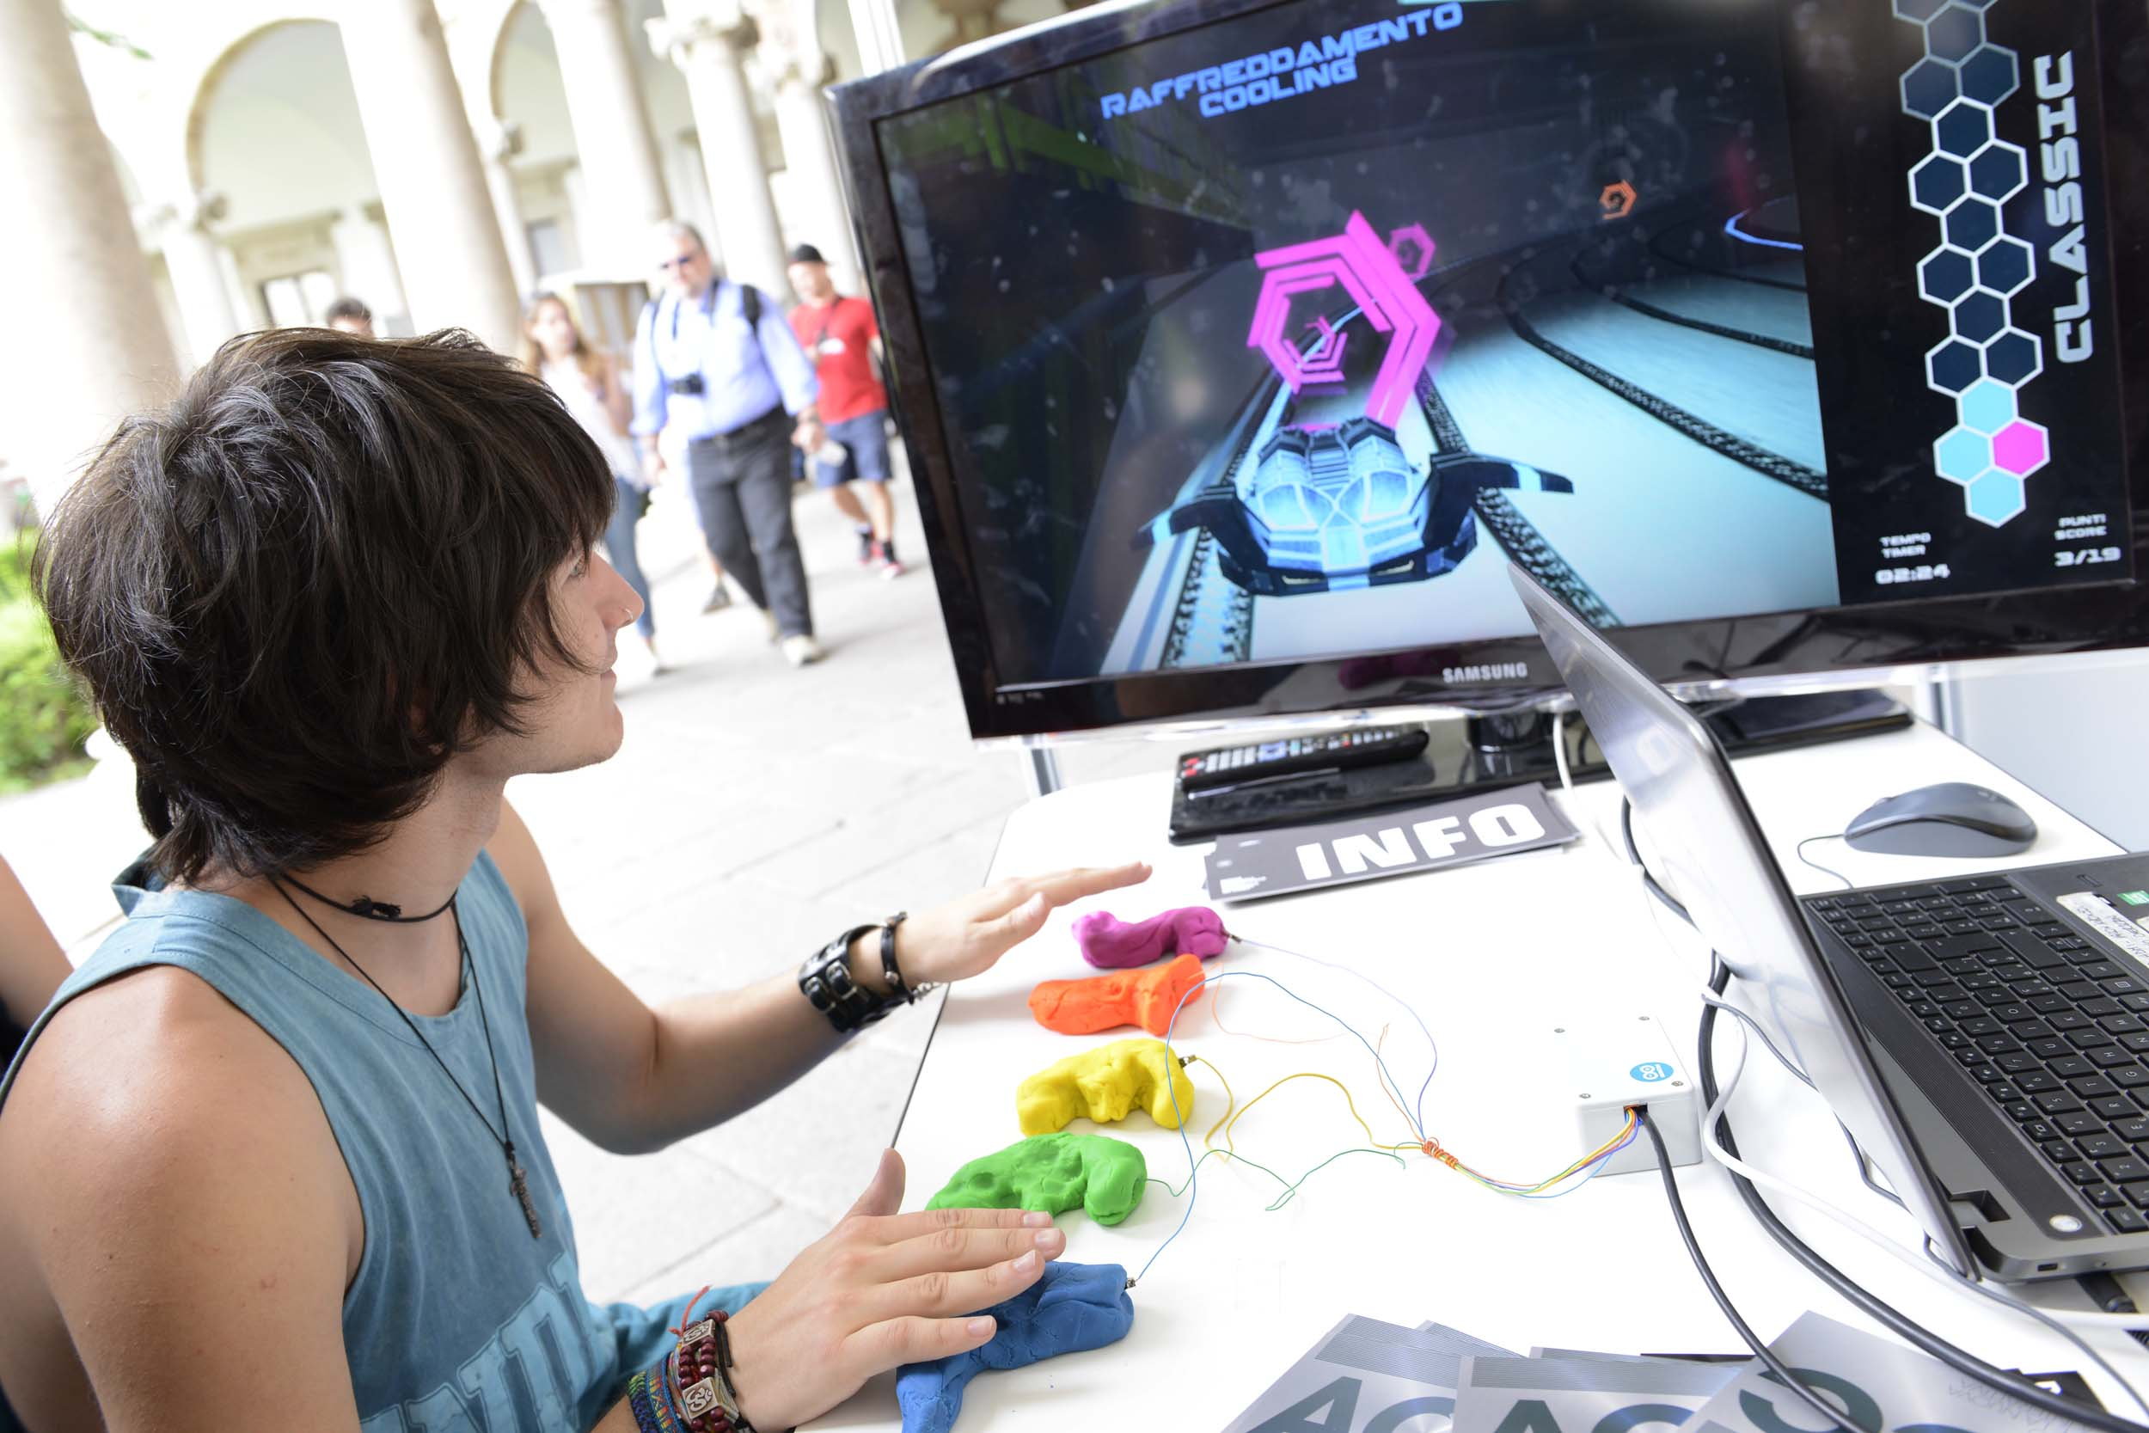
Job Profile
Video game designer
Hal Garner
Hal Garner has his dream job. He plays video games all day long! Hal is a game designer for a large video game company. He makes new games and tests them. It’s always exciting, and he almost always wins!
This Photo by Unknown Author is licensed under CC BY-NC-ND

Slide 7
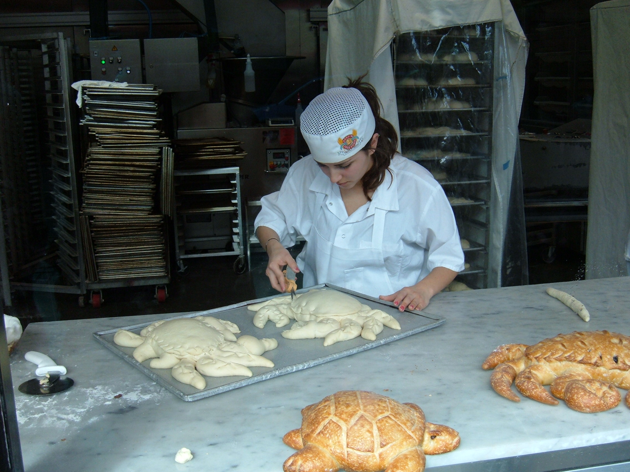
A baker
Junko Watanabe
Junko Watanabe has a sweet life. She makes bread, cookies, and cakes in her neighborhood bakery. Junko really likes her job. Her salary isn’t great, but the customers love her cakes and cookies, so she’s happy.
This Photo by Unknown Author is licensed under CC BY-SA

Slide 8
Exercises
Who said that?
Write in English.
“I go to work very early in the morning.” __________
“I know every restaurant in town.” ______________
“After work, I need to take a bath.” _____________
“I sit dow all day long.”
___________________
Qual é a profissão de Marco Mendez?
Como é o trabalho de Lila Martin?
Para quem Hal Garner trabalha?
Qual é a intensidade em que Junko gosta do trabalho dela?

Slide 9
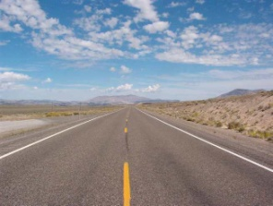

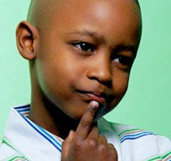
He is...

Slide 10


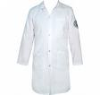
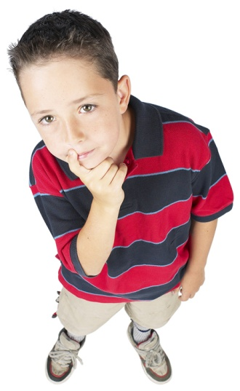

Slide 11

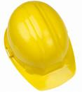

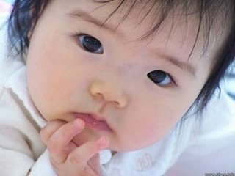

Slide 12
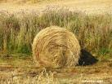
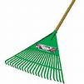
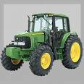
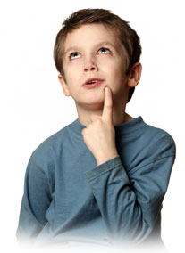

Slide 13
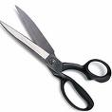

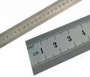
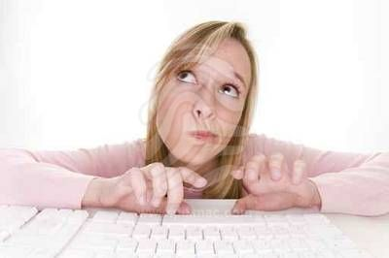

Slide 14
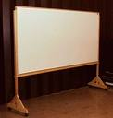

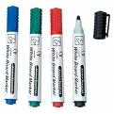
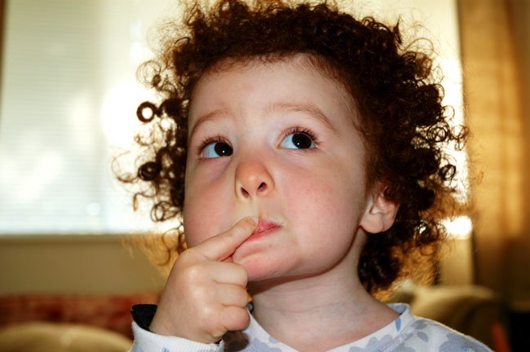

Slide 15
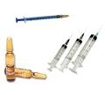
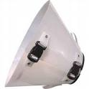
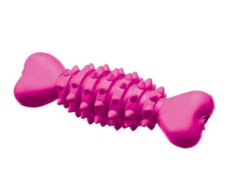
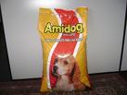
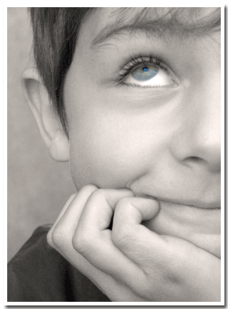

Slide 16

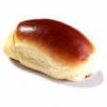
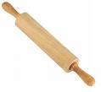
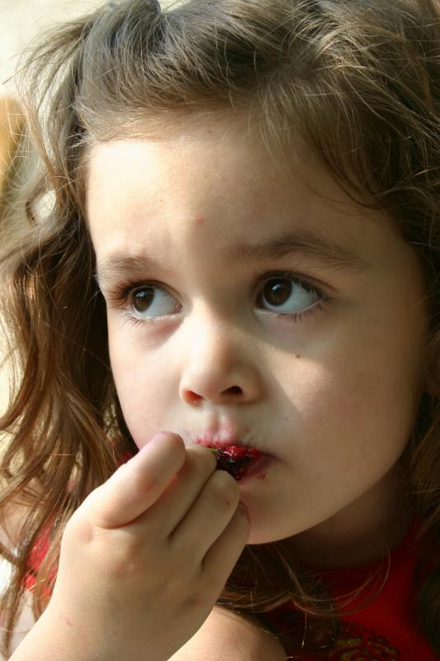

Slide 17


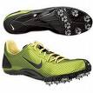
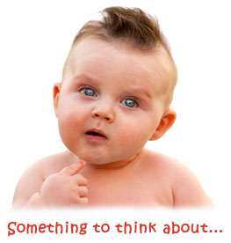


Slide 18

And you? What are you going to be when you grow up?

Slide 19

Homework:

